Slide 1
Replication

Slide 2
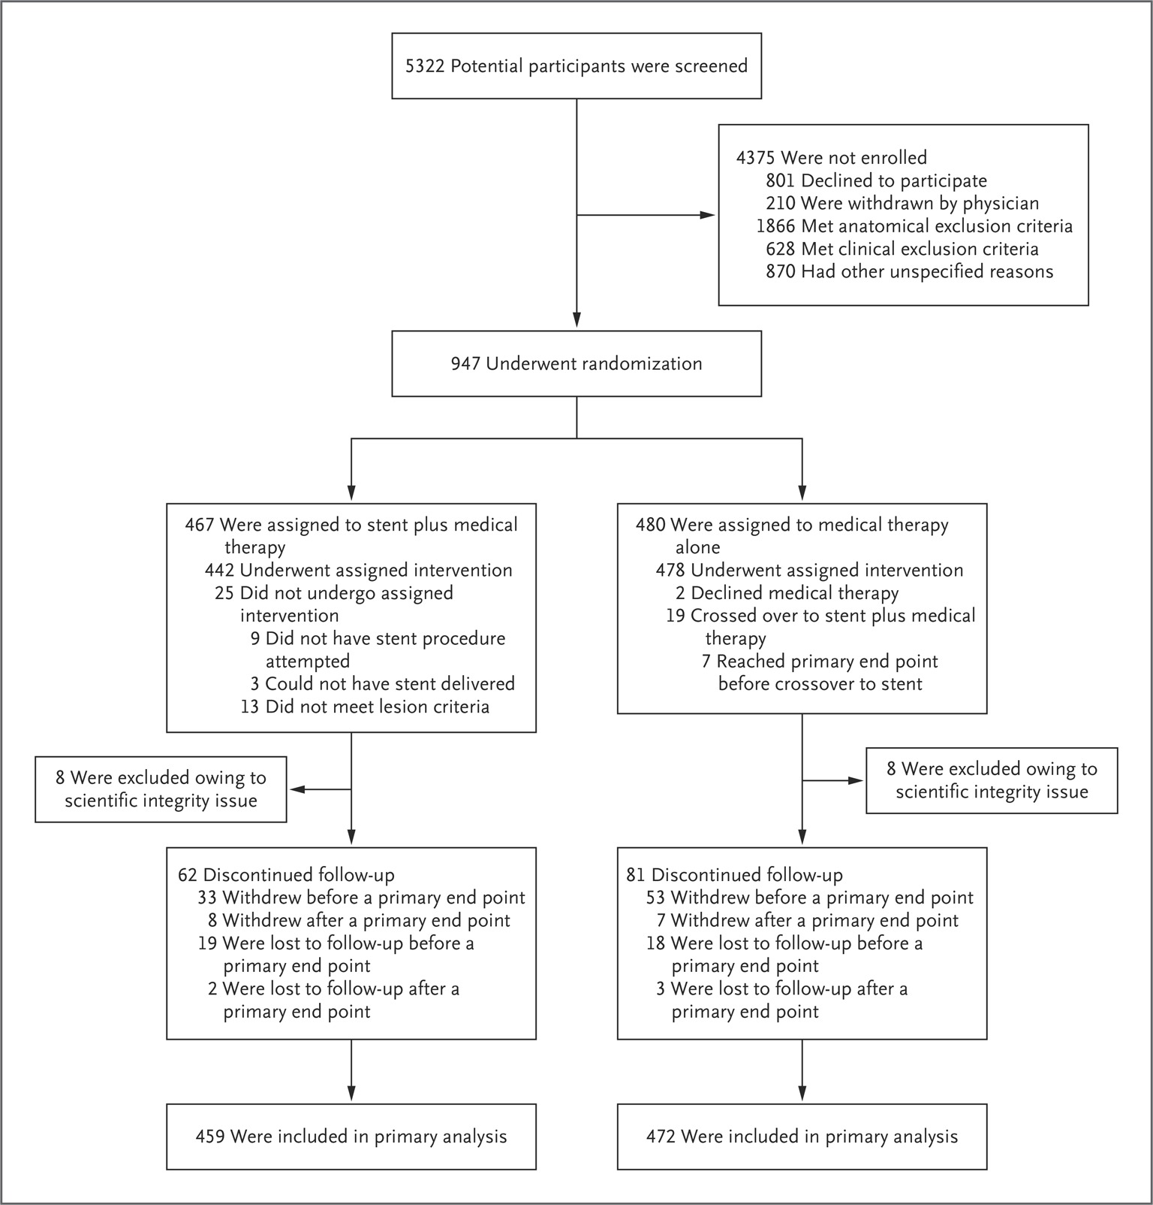
We got exactly 472 & 459 in each arm

Slide 3
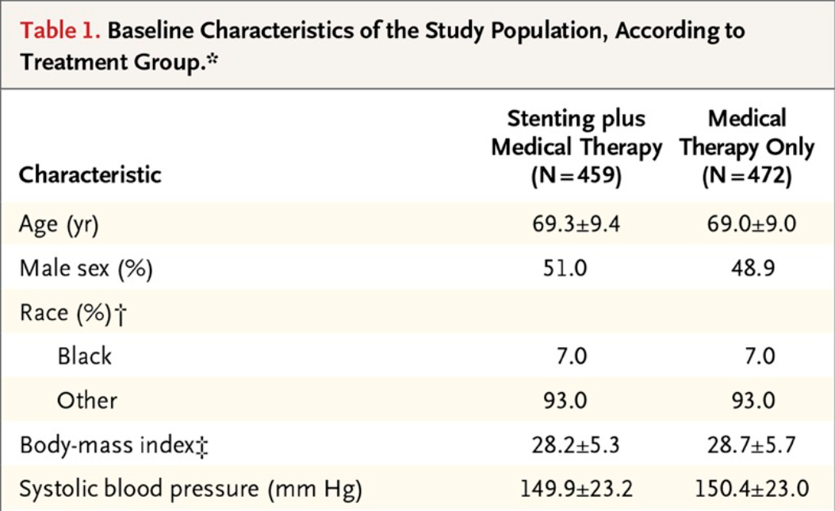








Identical

Slide 4
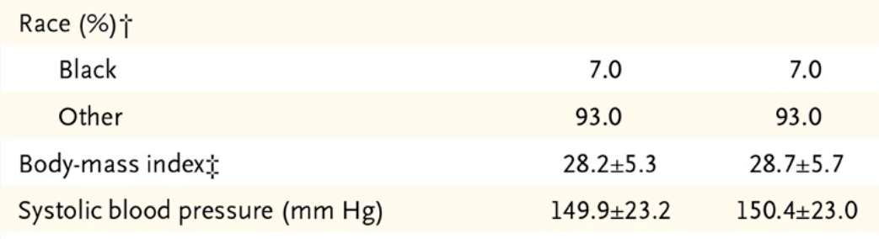














Identical
BMI is not perfectly identical here; but I guess because I converted inch/cm/lb/kg etc maybe some minor differences accumulated along the way

Slide 5
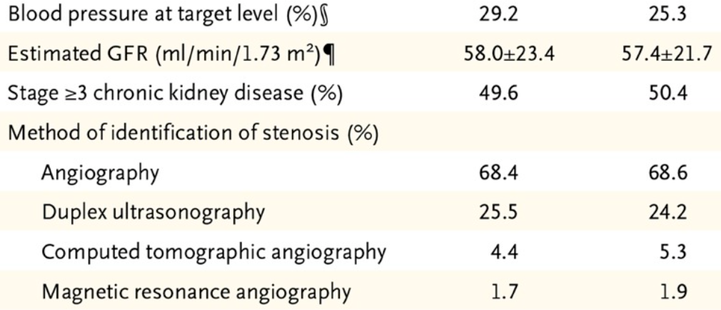






Let me know if these are absolutely necessary I can continue to find them
The egfr not sure how they got these number. A lot of the values in baseline dataset are >60; it could be 70 80 90 or 61. Also many gfrs right on point at 60.
Ill find these later

Slide 6
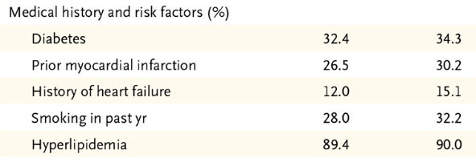
















replicated

Slide 7
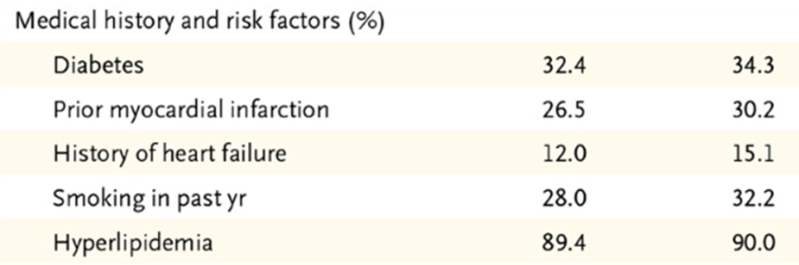



replicated

Slide 8
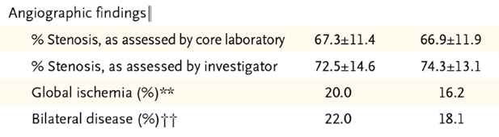
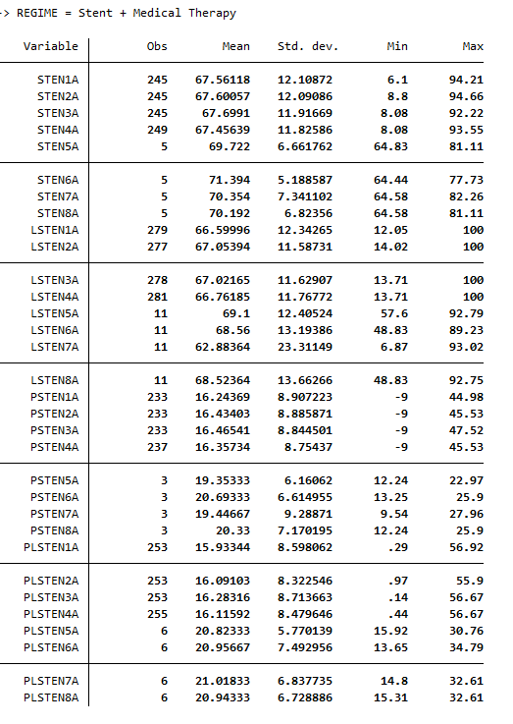
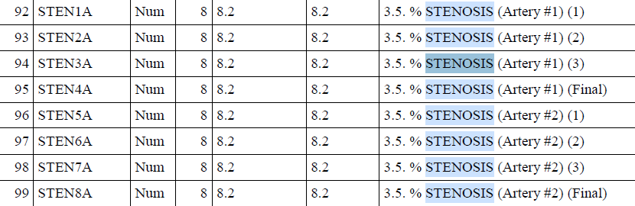
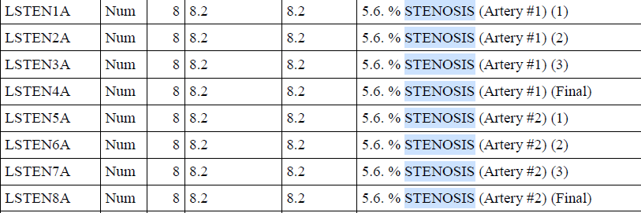
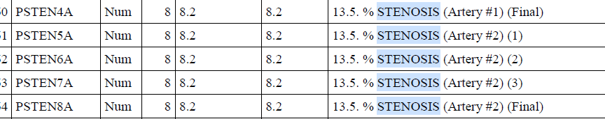
Data dictionary
← Patient with stents:

Slide 9
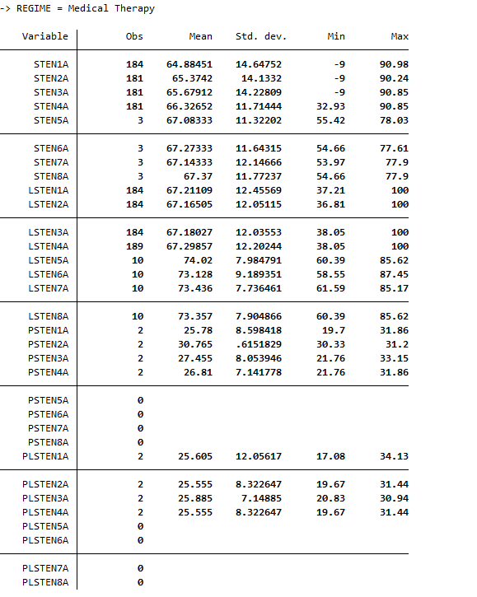
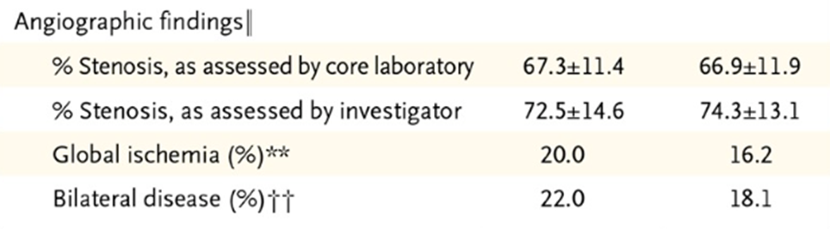
Patients on medical therapy →
Maybe L in front of LSTEN means laboratory determined
Not sure what PSTENs are.. ?accessory arteries?

Slide 10





Will dig more..
I actually forgot how I got these, was looking at different variables on stenosis and made this one up.. Will continue later

Slide 11
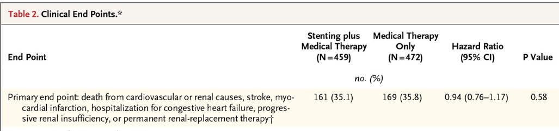


Finding endpoints
V1: According to supplementary files; TIA, silent Mis are included as well so I added those. And I gathered data from v1_renadjnew and added that onto cecrenl file. Or else the renal insufficiency number in cecrenl alone is way too low
V2: reran and updated the numbers, removed patients who had >1 events. Now I have (with TIA)
Without TIA; the toal is 322 which is 8 short of coral’s

Slide 12
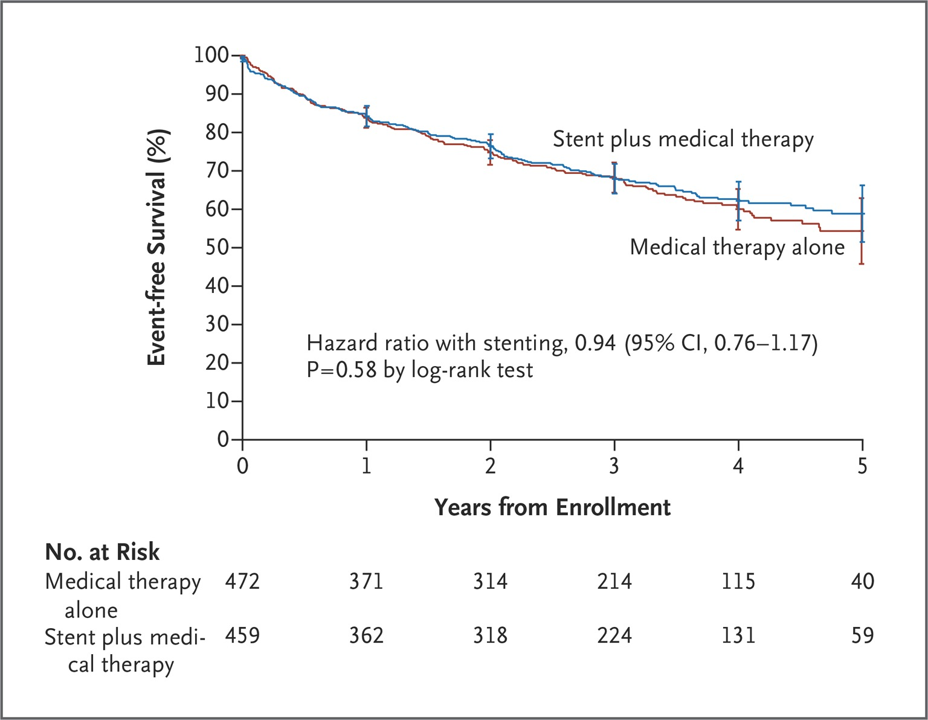


futile
Every follow up visits there is this “ANYENDPT” asking about endpoints so I tried using this method: Extract “ANYENDPT” from
2w, 4w, 6w, 8w, 3m……up to 5yr, but the total event rate is very low; only 20s for each arms. This is my Kaplan curve using this “anyendpt” varible event and time = each visit

Slide 13
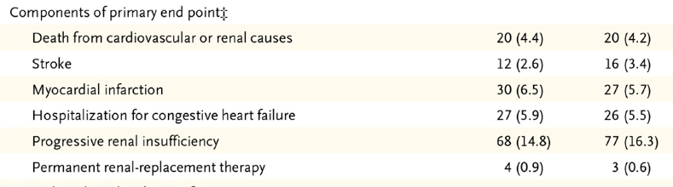
Still figuring out how to find these..
Right now I have the total num of patients (43 and 35) who expired 2/2 CV/renal cause. Original data only takes into account the 1st event
If a patient had multiple events- admitted for CHF and also had renal insufficiency, I’ll have to compare which one occurred first – will need some more time to figure this out- if you know the answer teach me thank you!

Slide 14
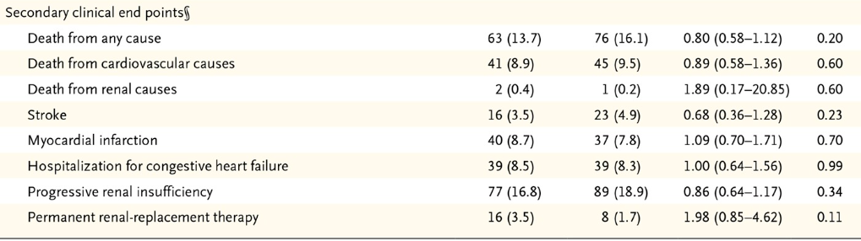










Work in progress
Updated on the start date- replaced if missing
Fixed.
done

Slide 15
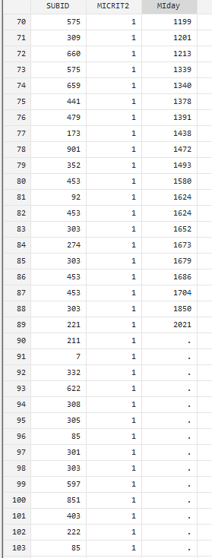
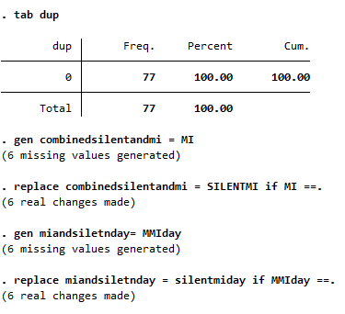
Myocardial infarction
Gen MI from 1+2, replaced the missing days.
Combined silent and mI data, saved as “MI event”

Slide 16
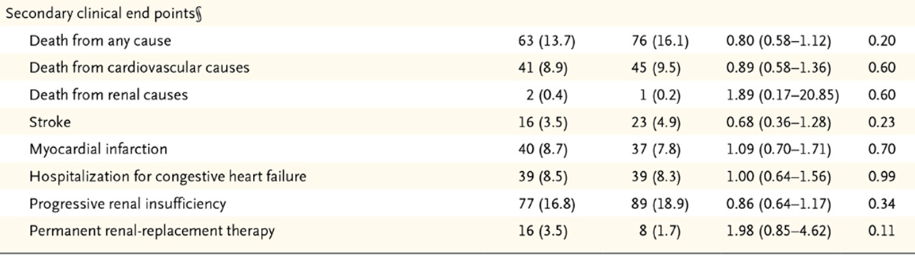









Still missing some people will continue finding..
Solved, if we exclude TIA
Solved

Slide 17
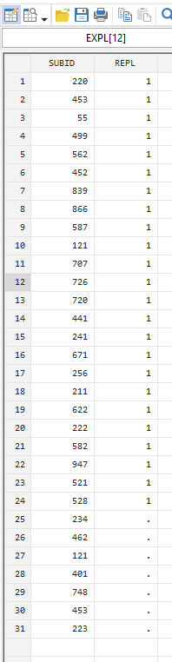



Renal replacement
From the renalrep.data; total 24 = coral reported data
I replaced the date if RRT strptday missing I used ceadjday
Ensured no duplicates

Slide 18
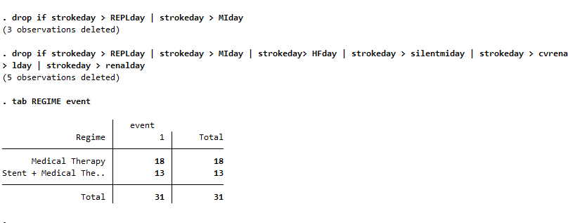


Secondary endpoint- stroke
If I filtered only the ones who presented with Stroke as the 1st event these are the numbers
If I calculate subjects who had Stroke (regardless of whether it is the 1st or 2nd primary composite event, the numbers are identical to CORAL. Note that this calculation is without TIA
- Also updated the missing day with cecadjday

Slide 19
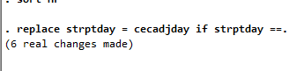


Secondary endpoint - HF
Screened through patients who were admitted or had new HF but did not meet criteria
CHFHOSP2 is a subset of CHFHOSP1
For duplicates, I only kept the 1st occurrence of HF (the earliest one), removed subsequent hospitalizations for the same patient and now it is identical

Slide 20






Death from any cause
Fit total 63+76
But cv death is less; no death in the mi/stroke dataset. None of them is duplicate; make sense cz death x1. none missing strtday

Slide 21
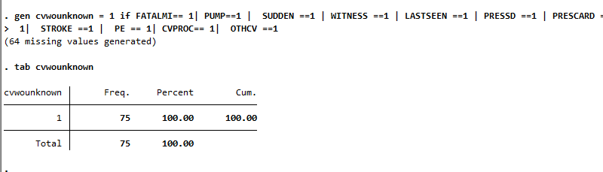
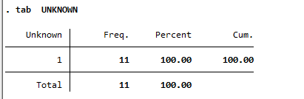
Unknown death looks like added into the cv death
Without unknown death, 75 patients had CV events

Slide 22
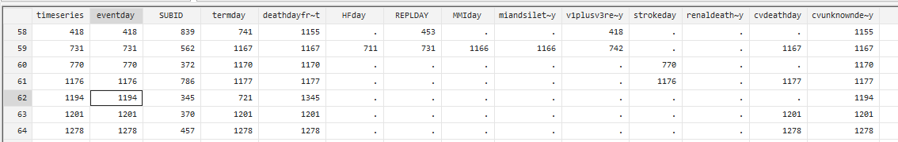


Some inconsistencies
Subid 345 deathday from death registry is 1345 but Cvdeath day is 1194
Or else the rest of the deathdayfrom death registry == CV death day
Termday vs death registry day, which one to use?
If no events but die of unknown cause; should they be counted as firstevent? (SUBID 419, 361, 199, 395, 839)
SUBID 894 deathregistry date =/= unknown cause death

Slide 23
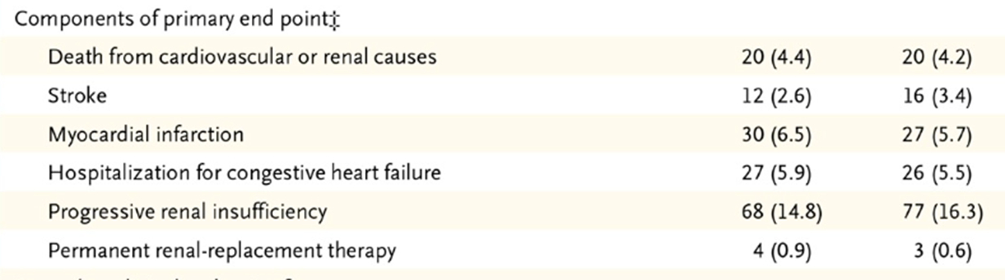













Primary end point differs by points…
I passed on the min day among the RRT, renal insufficiency, MI day ofr each subject and chose the min day and replaced it as string function
For dataset with multiple recurrence events like MI HF and AKI I did filter through the duplicates and select only the first event for each subject
I manually checked through them as well… not sure why these are inconsistent with the coral ones

Slide 24
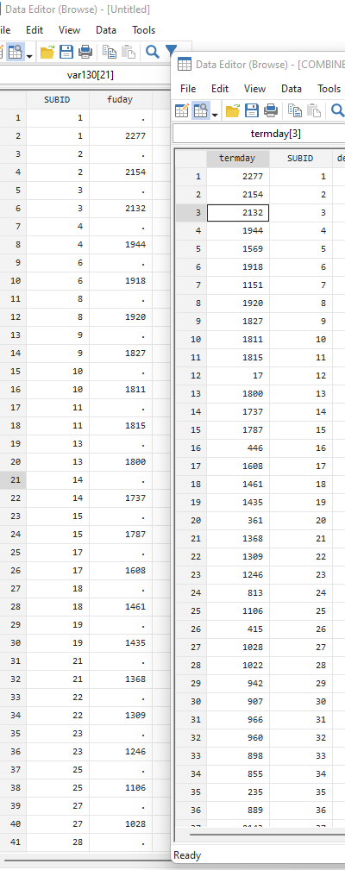
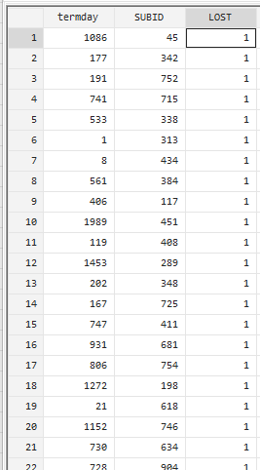




I used termday for calculation
Dataset contcompl seems like is the last set of follow up data after 5 yr, the fuday = follow up day is nearly identical to term day in the exit.dataset
LOST is lost to follow up but termday has the dates as well

Slide 25
Coral on the left mine on the right

Slide 26
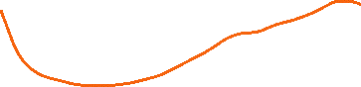

Close but not quite (V1)
There are 2 missing days recorded on either event/last contact
3 participant had events on day 0 – 2 had stroke and 1 had renal insufficiency

Slide 27
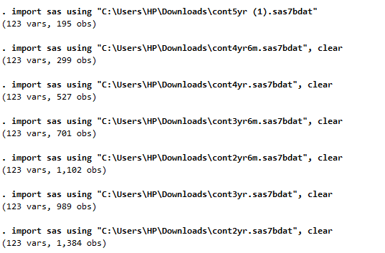
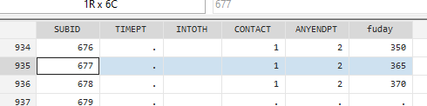
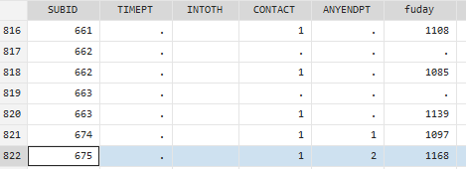
V2 (after I have more events numbers in HF, removed TIA, removed duplicates based on the num of events and updated the missing date.
Failure event: event==1
Observed time interval: (0, timeseries]
Exit on or before: failure31 total observations
2 event time missing (timeseries>=.)
3 observations end on or before enter()
926 observations remaining, representing
319 failures in single-record/single-failure data
930,896 total analysis time at risk and under observation
SUBID 677 and 675 missing, not in “LOST”, not in nrfunot.sas7bdat / contoth (2).sas7bdat
\v3_pdev.sas7bdat 675 = 539 , 677 not found
675 in follow up 3 yr (1168) and 2 ½ yr no endpt
677 found in follow up 1 yr. endpt no

Slide 28
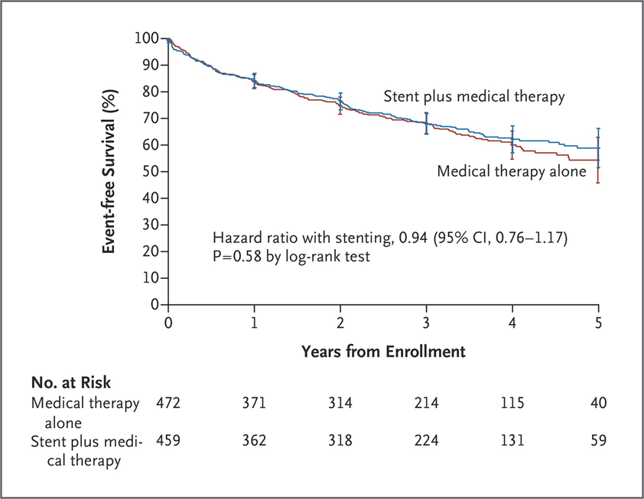
Restrict to day <1781 (5yr)

Slide 29
Added the unknown death

Slide 30
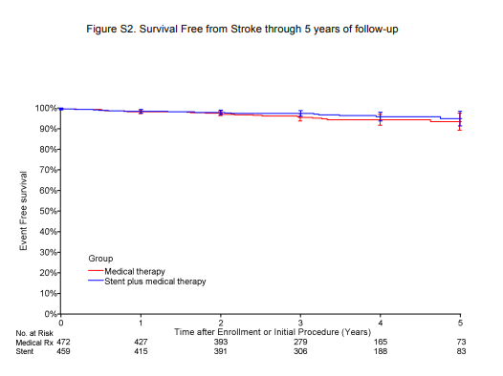
From coral mine
Figure S2. Survival Free from Stroke through 5 years of follow-up (supplementary files)
Need more to time to figure this…

